Slide 1
Testing
Instructor: Mehroze Khan

Slide 2
Unit Testing Code Review
Code walkthrough
In a walkthrough, you present your code and accompanying documentation to the review team, and the team comments on their correctness.
Code inspection
In an inspection, the review team checks the code and documentation against a prepared list of concerns. It is more formal.

Slide 3
Unit Testing
Testing the unit for correct functionality
Testing the unit for correct execution

Slide 4
Unit Testing Steps in Testing
Determining test objectives
Selecting test cases
Executing test cases

Slide 5
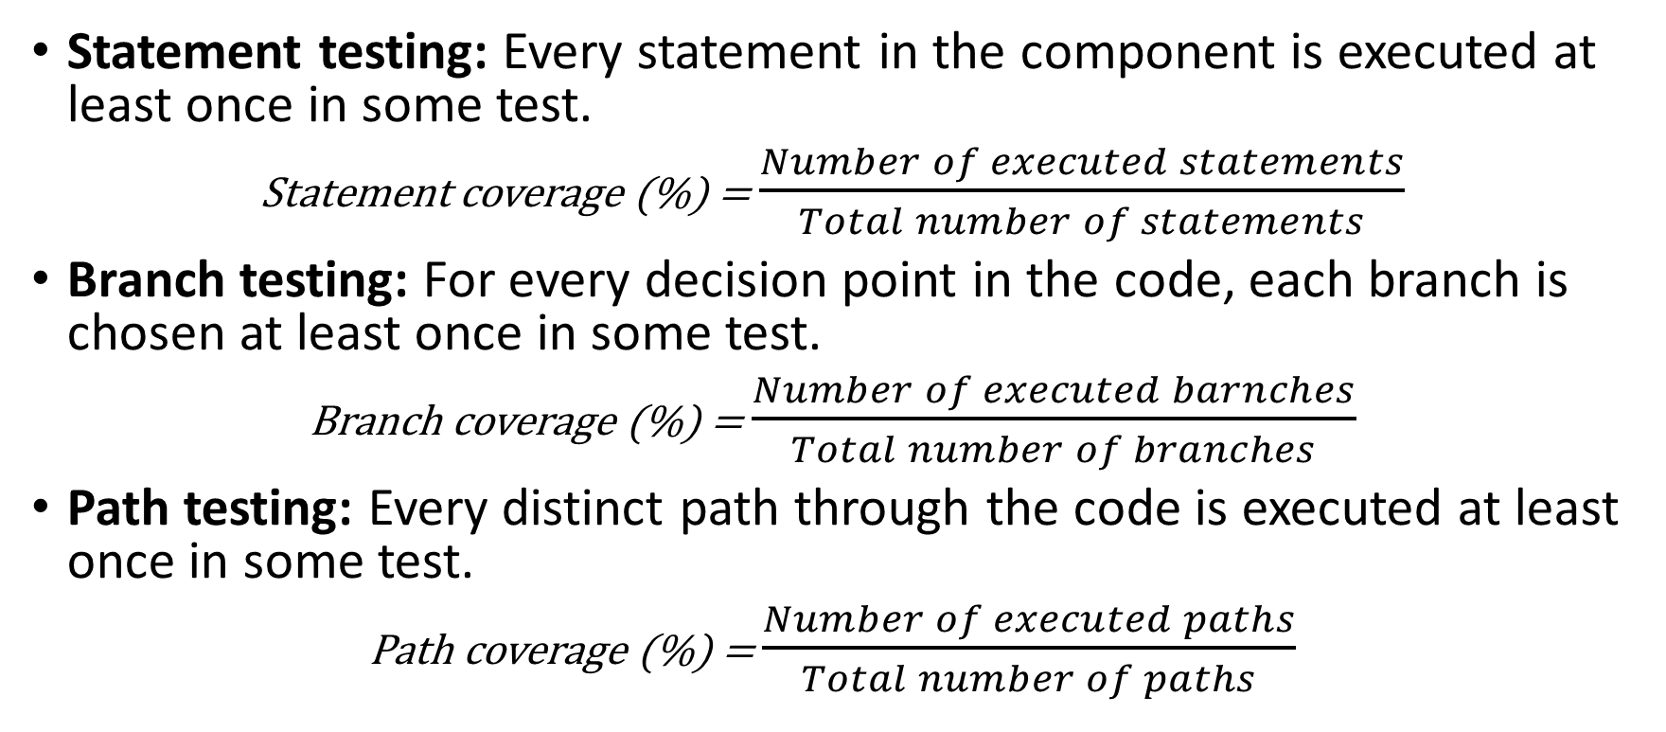
Unit Testing Whitebox Test Thoroughness
Statement testing: Every statement in the component is executed at least once in some test.
Statement coverage (%) = $\frac{Number of executed statements}{Total number of statements}$
Branch testing: For every decision point in the code, each branch is chosen at least once in some test.
Branch coverage (%) = $\frac{Number of executed barnches}{Total number of branches}$
Path testing: Every distinct path through the code is executed at least once in some test.
Path coverage (%) = $\frac{Number of executed paths}{Total number of paths}$

Slide 6
Example
void Result (int x, int y)
{ int result = x + y;
if (result > 0)
print << “Positive”;
else if (result < 0)
print << “Negative”;
}

Slide 7
Integration Testing
Big-bang
Bottom-up
Top-down
Sandwich testing

Slide 8
Integration Testing Terminology
Component Driver: a routine that calls a particular component and passes a test case to it
Stub: a special-purpose program to simulate the activity of the missing component

Slide 9
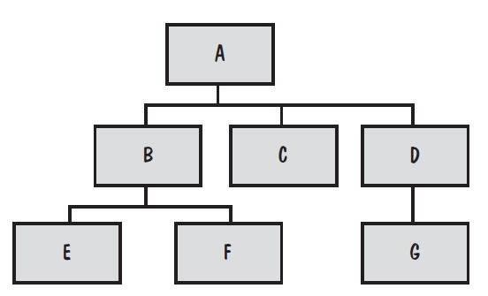
Integration Testing
System viewed as a hierarchy of components

Slide 10
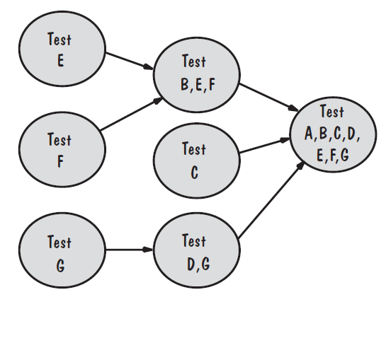
Integration Testing Bottom-Up Integration Example
Drivers are used to call the child functions
Drivers are relatively intelligent
Non-leave drivers
Locating faults?

Slide 11
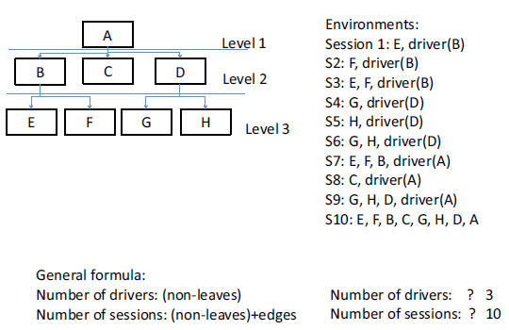
Integration Testing Bottom-Up Integration Example
Notes:
A frequent complaint about bottom-up testing in a functionally decomposed system is that the top-level components are usually the most important but the last to be tested. The top level directs the major system activities, whereas the bottom level often performs the more mundane tasks, such as input and output functions or repetitive calculations

Slide 12
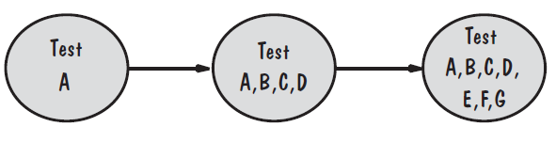
Integration Testing Top-Down Integration Example
Only A is tested by itself
Stubs of B, C and D are used at first level
N-1 stubs required (N=Number of nodes)
Locating faults?
Notes:
A disadvantage to top-down testing is the possibility that a very large number of stubs may be required. This situation can arise when the lowest system level contains many general-purpose routines.

Slide 13
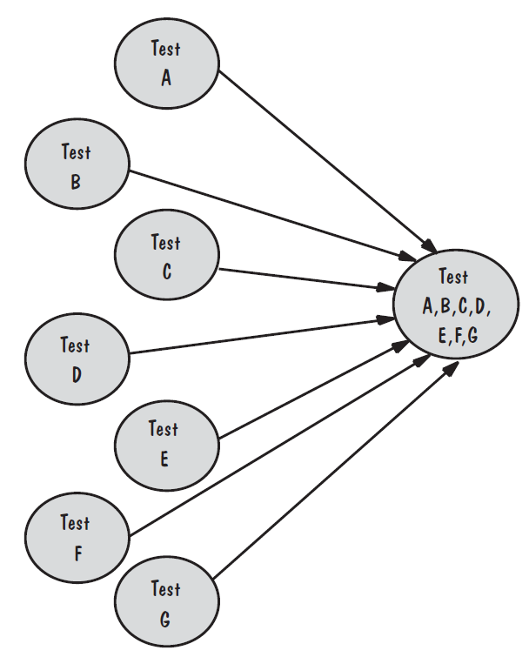
Integration Testing Bing-Bang Integration Example
All components are tested in isolation,
then mixed together as the final system
and evaluated if it works the first time
Requires stubs and drivers
Locating faults?

Slide 14
Integration Testing Sandwich Integration Example
View system as three layers
Employ Bottom-Up where
writing drivers is not costly
Employ Top-Down where
stubs are easier to write
Locating faults?

Slide 15
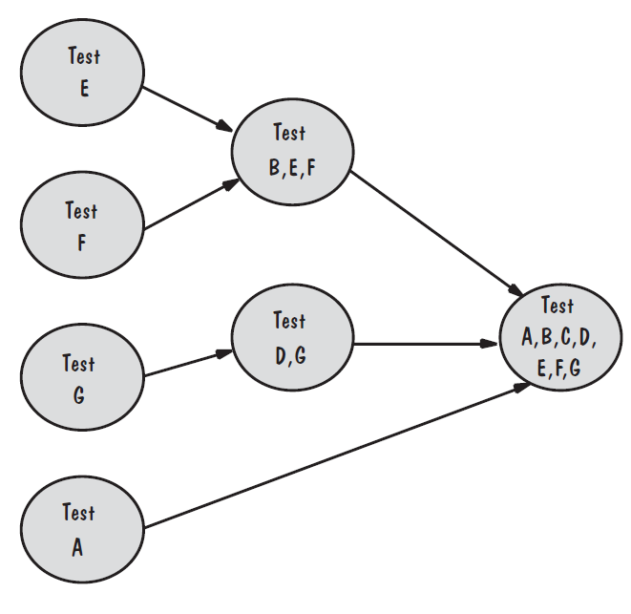
Integration Testing Sandwich Integration Example
Viewed system as three layers
Employ Bottom-Up where
writing drivers is not costly
Employ Top-Down where
stubs are easier to write
Locating faults?

Slide 16
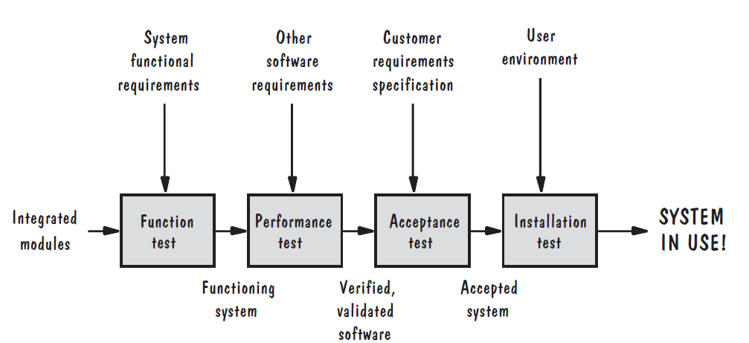
System Testing
There are several steps in testing a system:
1. function testing
2. performance testing
3. acceptance testing
4. installation testing

Slide 17
System Testing
Process Objectives.
Initially, we test the functions performed by the system.
We begin with a set of components that were tested individually and then together.
A function test checks that the integrated system performs its functions as specified in the requirements.
For example, a function test of a bank account package verifies that the package can correctly credit a deposit, enter a withdrawal, calculate interest, print the balance, and so on.

Slide 18
System Testing
Once the test team is convinced that the functions work as specified, the performance test compares the integrated components with the nonfunctional system requirements.
These requirements, including security, accuracy, speed, and reliability, constrain the way in which the system functions are performed.
For instance, a performance test of the bank account package evaluates the speed with which calculations are made, the precision of the computation, the security precautions required, and the response time to user inquiry.
At this point, the system operates the way the designers intend. We call this a verified system

Slide 19
System Testing
So far, all the tests have been run by the developers, based on their understanding of the system and its objectives.
The customers also test the system, making sure that it meets their understanding of the requirements, which may be different from the developers’.
This test, called an acceptance test, assures the customers that the system they requested is the system that was built for them.

Slide 20
System Testing
The acceptance test is sometimes run in its actual environment but often is run at a test facility different from the target location.
For this reason, we may run a final installation test to allow users to exercise system functions and document additional problems that result from being at the actual site.
For example, a naval system may be designed, built, and tested at the developer’s site, configured as a ship might be, but not on an actual ship. Once the development site tests are complete, an additional set of installation tests may be run with the system on board each type of ship that will eventually use the system.

Slide 21
Steps to do System Testing
The following steps are important to perform System Testing:
Step 1: Create a System Test Plan
Step 2: Create Test Cases
Step 3: Carefully Build Data used as Input for System Testing
Step 3: If applicable create scripts to
- Build environment
- To automate Execution of test cases
Step 4: Execute the test cases
Step 5: Fix the bugs if any and retest the code
Step 6: Repeat the test cycle as necessary

Slide 22
Principles of System Testing Configuration Management
A system configuration is a collection of system components delivered to a particular customer.
Versions and releases
Regression Testing
Production system vs. development system
Deltas, separate files and conditional compilation
Change control
Notes:
A configuration for a particular system is sometimes called a version. The initial delivery of a software package may consist of several versions, one for each platform or situation in which the software will be used. For example, aircraft software may be built so that version 1 runs on Navy planes, version 2 runs on Air Force planes, and version 3 runs on commercial airliners.
As the software is tested and used, faults are discovered that need correction, or minor enhancements are made to the initial functionality. A new release of the software is an improved system intended to replace the old one. Software systems are described as version n, release m, or as version n.m, where the number reflects the system’s position as it grows and matures.
A production system is a version that has been tested and performs according to only a subset of the customer’s requirements.
The next version, with more features, is developed while users operate the production system. This development system is built and tested; when testing is complete, the development system replaces the production system to become the new production system.
There are three primary ways to control versions and releases. Some development projects prefer to keep separate files for each different version or release.
We need store only the differences, rather than all the components, for each of the other versions. The difference file, called a delta, contains editing commands that describe how the main version is to be transformed to a different version. Deltas are especially useful for maintaining releases. The first release is considered to be the main system, and subsequent releases are recorded as a set of deltas to release 1.
A third approach to controlling file differences is to use conditional compilation. That is, a single code component addresses all versions. Conditional statements use the compiler to determine which statements apply to which versions.
The configuration management team performs change control. The team oversees the libraries of code and documents, and developers must “check out” copies when making fixes.

Slide 23
Principles of System Testing Regression Testing
Identifies new faults that may have been introduced as current one are being corrected
Verifies a new version or release still performs the same functions in the same manner as an older version or release

Slide 24
Principles of System Testing Regression Testing Steps
Inserting the new code
Testing functions known to be affected by the new code
Testing essential function of m to verify that they still work properly
Continuing function testing m + 1

Slide 25
Acceptance Tests Purpose and Roles
Enable the customers and users to determine if the built system meets their needs and expectations
Written, conducted and evaluated by the customers

Slide 26
Acceptance Tests Types of Acceptance Tests
Pilot test: install on experimental basis
Alpha test: in-house test
Beta test: customer’s pilot
Parallel testing: new system operates in parallel with old system
Notes:
A pilot test installs the system on an experimental basis. Users exercise the system as if it had been installed permanently. Pilot tests rely on the everyday working of the system to test all functions
Sometimes, we test a system with users from within our own organization or company before releasing the system to the customer; we “pilot” the system before the customer runs the real pilot test. Our in-house test is called an alpha test
The customer’s pilot is a beta test. This approach is common when systems are to be released to a wide variety of customers. For example, a new version of an operating system may be alpha tested at our own offices and then beta-tested using a specially selected group of customer sites. We try to choose as beta-test sites customers who represent all kinds of system usage.
In parallel testing, the new system operates in parallel with the previous version. The users gradually become accustomed to the new system but continue to use the old one to duplicate the new. This gradual transition allows users to compare and contrast the new system with the old. It also allows skeptical users to build their confidence in the new system by comparing the results obtained with both and verifying that the new system is just as effective and efficient as the old.

Slide 27
Result of Acceptance Tests
List of requirements that
are not satisfied
must be deleted
must be revised
must be added

Slide 28
Installation Testing
Before the testing
Configure the system
Attach proper number and kind of devices
Establish communication with other system
The testing
Regression tests: to verify that the system has been installed properly and works

Slide 29
Software Testing Tools
Automated Testing Tools
Selenium, QTP, SilkTest, WinRunner, LoadRunner, Jmeter
Testing Management Tools
TestManager, TestDirector
Bug Tracking/Configuration Management Tools
Bugzilla, Jitterbug, SilkRadar

Slide 30
When to Stop Testing
No time left
No money left
Statistical Criteria
Number of defects found per week becomes lower than a set threshold

Slide 31
Test Documentation
Test plan: describes system and plan for exercising all functions and characteristics
Test specification and evaluation: details each test and defines criteria for evaluating each feature
Test description: test data and procedures for each test
Test analysis report: results of each test

Slide 32
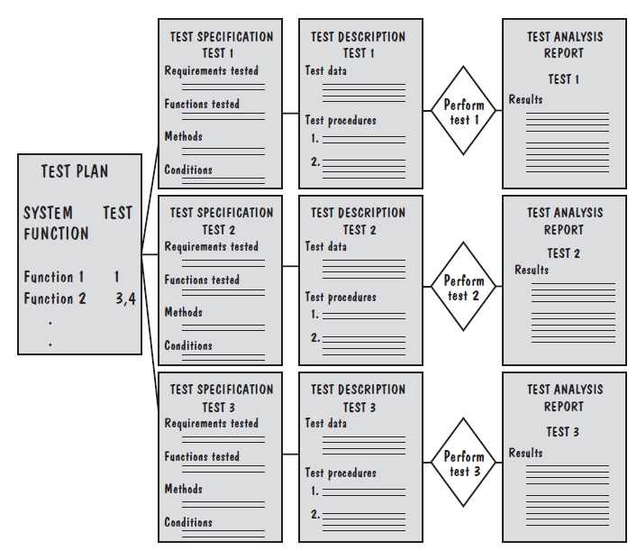
Test Documentation Documents Produced During Testing

Slide 33
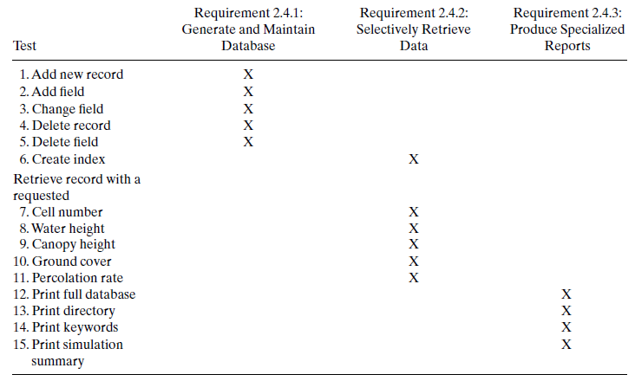
Testing Documentation Test-Requirement Correspondence Chart

Slide 34
Test Documentation Test Description Example
Test data for a test of a SORT routine may be the following:
INPUT DATA:
Input data are to be provided by the LIST program. The program
generates randomly a list of N words of alphanumeric characters;
each word is of length M. The program is invoked by calling
RUN LIST(N,M)in your test driver. The output is placed in global data area LISTBUF. The test datasets to be used for this test are as follows:
Case 1: Use LIST with N=5, M=5
Case 2: Use LIST with N=10, M=5
Case 3: Use LIST with N=15, M=5
Case 4: Use LIST with N=50, M=10
Case 5: Use LIST with N=100, M=10
Case 6: Use LIST with N=150, M=10

Slide 35
Test Documentation Test Description Example
INPUT COMMANDS:
The SORT routine is invoked by using the command
RUN SORT (INBUF,OUTBUF) or
RUN SORT (INBUF)
OUTPUT DATA:
If two parameters are used, the sorted list is placed in OUTBUF.
Otherwise, it is placed in INBUF.
SYSTEM MESSAGES:
During the sorting process, the following message is displayed:
“Sorting...please wait...”
Upon completion, SORT displays the following message on the screen:
“Sorting completed”
To halt or terminate the test before the completion message is
displayed, press CONTROL-C on the keyboard.

Slide 36
Test Documentation Test Script for Testing The “change field”
Step N: Press function key 4: Access data file.
Step N+1: Screen will ask for the name of the date file.
Type ‘sys:test.txt’
Step N+2: Menu will appear, reading
* delete file * modify file * rename file
Place cursor next to ‘modify file’ and press
RETURN key.
Step N+3: Screen will ask for record number. Type ‘4017’.
Step N+4: Screen will fill with data fields for record 4017:
Record number: 4017 X: 0042 Y: 0036
Soil type: clay Percolation: 4 mtrs/hr
Vegetation: kudzu Canopy height: 25 mtrs
Step N+5: Press function key 9: modify
Step N+6: Entries on screen will be highlighted.
Move cursor to VEGETATION field.
Type ‘grass’ over ‘kudzu’ and press RETURN key.
Notes:
A test procedure is often called a test script because it gives us a step-by-step description of how to perform the test.

Slide 37
Test Documentation Test Script for Testing The “change field”
Step N+7: Entries on screen will no longer be highlighted.
VEGETATION field should now read ‘grass’.
Step N+8: Press function key 16: Return to previous screen.
Step N+9: Menu will appear, reading
* delete file * modify file * rename file
To verify that the modification has been recorded, place cursor next to ‘modify file’ and press RETURN key.
Step N+10: Screen will ask for record number. Type ‘4017’.
Step N+11: Screen will fill with data fields for record 4017:
Record number: 4017 X: 0042 Y: 0036
Soil type: clay Percolation: 4 mtrs/hr
Vegetation: grass Canopy height: 25 mtrs
Notes:
A test procedure is often called a test script because it gives us a step-by-step description of how to perform the test.

Slide 38
Test Documentation Test Analysis Report
Documents the result of test
Provides information needed to duplicate the failure and to locate and fix the source of the problem
Provides information necessary to determine if the project is complete
Establish confidence in the system’s performance

Slide 39
Test Documentation Problem Report Forms
Location: Where did the problem occur?
Timing: When did it occur?
Symptom: What was observed?
End result: What were the consequences?
Mechanism: How did it occur?
Cause: Why did it occur?
Severity: How much was the user or business affected?
Cost: How much did it cost?
Notes:
During testing, we capture data about faults and failures in problem report forms.
A discrepancy report form is a problem report that describes occurrences of problems where actual system behaviors or attributes do not match with what we expect. It explains what was expected, what happened, and the circumstances leading to the failure.
A fault report form explains how a fault was found and fixed, often in response to the filing of a discrepancy report form.

Slide 40
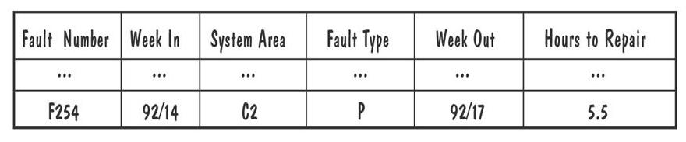
Test Documentation Example of Actual Problem Report Forms

Slide 41
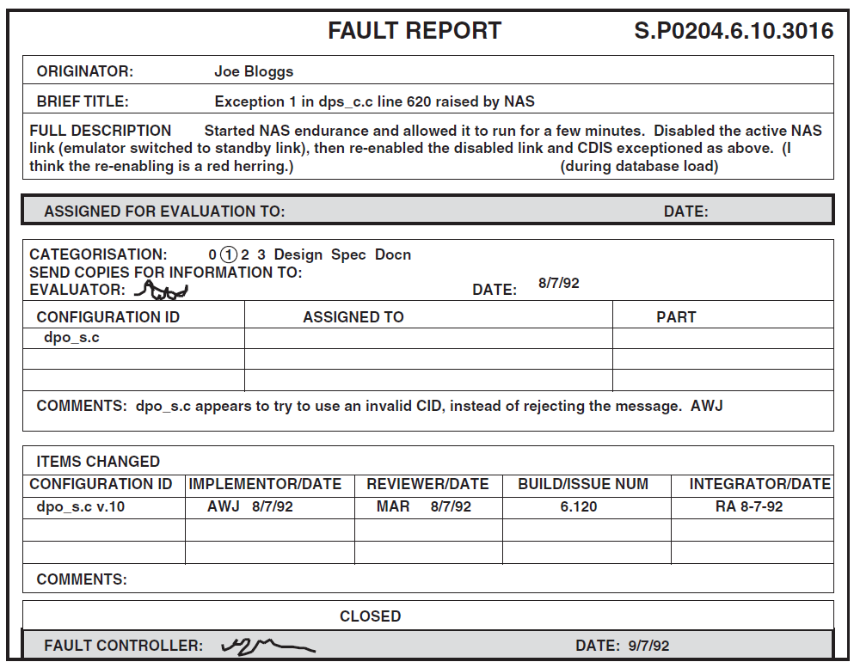
Test Documentation Example of Actual Discrepancy Report Forms
Notes:
A fault report reflects the developer’s understanding of the fault’s impact on the system. A discrepancy report should reflect a user’s view of the failure caused by a fault.

Slide 42
References
Shari PFleeger, Joanne Atlee, Software Engineering: Theory and Practice, 4th Edition
Roger S. Pressman, Software Engineering A Practitioner’s Approach, 9th Edition. McGrawHill

